Slide 1
The Inscribing of the Paschal Candle

Slide 2
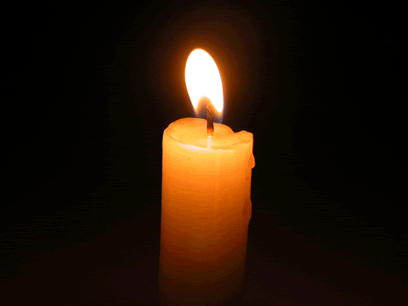
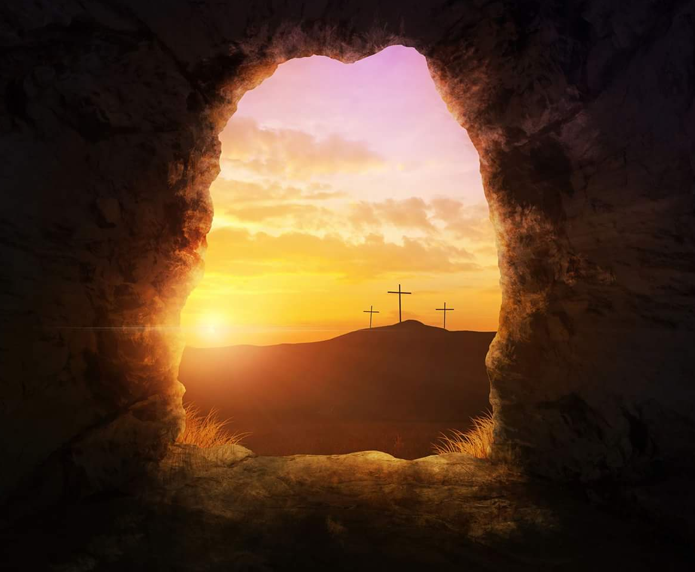
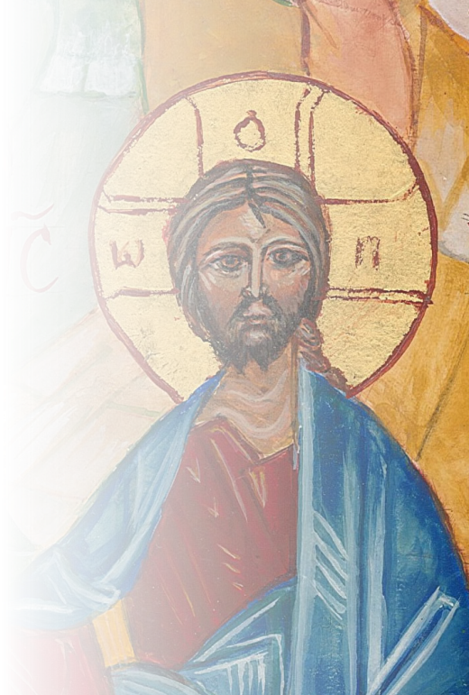
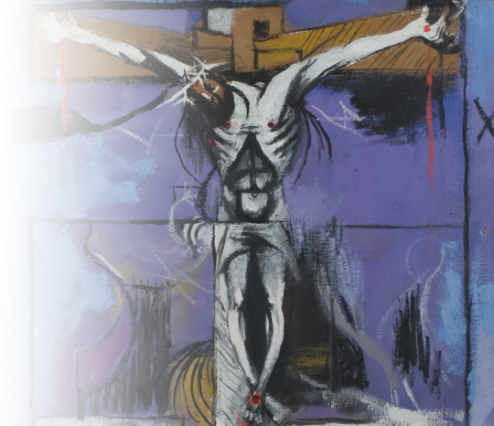
A
lpha
By His
holy
To Him
be glory
and power
All
time
belongs
to
Him
Christ,
yesterday
and today.
2
0
and glorious
wounds
through
every age
and for ever.
Amen.
The beginning
and the end.
2
1
may Christ
the Lord
A
and
all
the
ages.
2
0
2
1
guard us
and protect us.
Amen.
Ω
Ω
mega

Slide 3
The Inscribing of the Paschal Candle
Text Roman Missal © 2010 International Committee on English in the Liturgy
Icon Christ the Teacher © 2014 Jesuit Institute London
Sketch for the Crucifixion (1946) by Graham Sutherland (1903-1980)
PowerPoint animation © 2018 Jesuit Institute London

Slide 4
A
lpha
To Him
be glory
and power
All
time
belongs
to
Him
Christ,
yesterday
and today.
2
0
through
every age
and for ever.
Amen.
The beginning
and the end.
1
8
A
and
all
the
ages.
2
0
1
9
Ω
Ω
mega

